Slide 1
Feature Engineering (FE) & EDA - Financial Markets Assignment
APAN5420 - Anomaly Detection HW1
Zhenyu WANG

Slide 2
Part 1: summary of paper reading
The paper that I selected was "Data-snooping, technical trading rule performance and the bootstrap".
The article examines the performance of technical trading rules.
It utilizes White's Reality Check Bootstrap method to evaluate rule performance and correct for data snooping bias.
26 trading rules were applied to 100 years of daily data for the Dow Jones Industrial Average.
Data snooping bias, or the impact of exploring multiple rules, is considered in the analysis.
Despite data snooping, some trading rules demonstrate strong performance during the research period.
The article emphasizes the importance of addressing data exploration effects when assessing financial performance.
Adjusted p-values, considering data exploration, can significantly differ from unadjusted p-values.
The Sharpe ratio criterion is used to contrast performance, revealing substantial differences.
Out-of-sample performance is also assessed using recursive decision rules.
Interestingly, cumulative wealth rules did not perform well in out-of-sample testing, and some resulted in negative returns.
The best rule for DJIA had only six trades with long average holding periods compared to the full sample.
Notes:
In this article, the author explores the performance of technical trading rules in financial markets, employing White's Reality Check Bootstrap method to address data snooping bias while applying 26 trading rules to a century's worth of daily data for the Dow Jones Industrial Average. Despite concerns about data snooping, some trading rules exhibit consistent strong performance. This research underscores the crucial importance of accounting for data exploration effects when evaluating financial performance, with adjusted p-values often differing significantly from their unadjusted counterparts. When using the Sharpe ratio as a benchmark, the impact of data snooping on performance evaluations becomes even more apparent. Furthermore, out-of-sample testing reveals that cumulative wealth rules, a specific trading strategy, do not always perform as expected and may even result in negative returns. Intriguingly, the best-performing rule for the DJIA had only a few trades, each with significantly longer holding periods compared to the full sample. This article serves as a reminder that historical performance does not guarantee future success, emphasizing the need for rigorous evaluation and testing in financial decision-making.

Slide 3
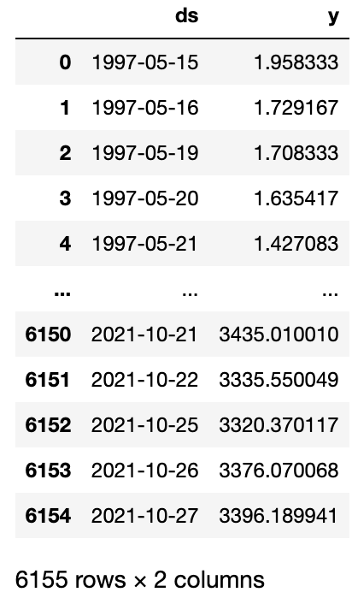
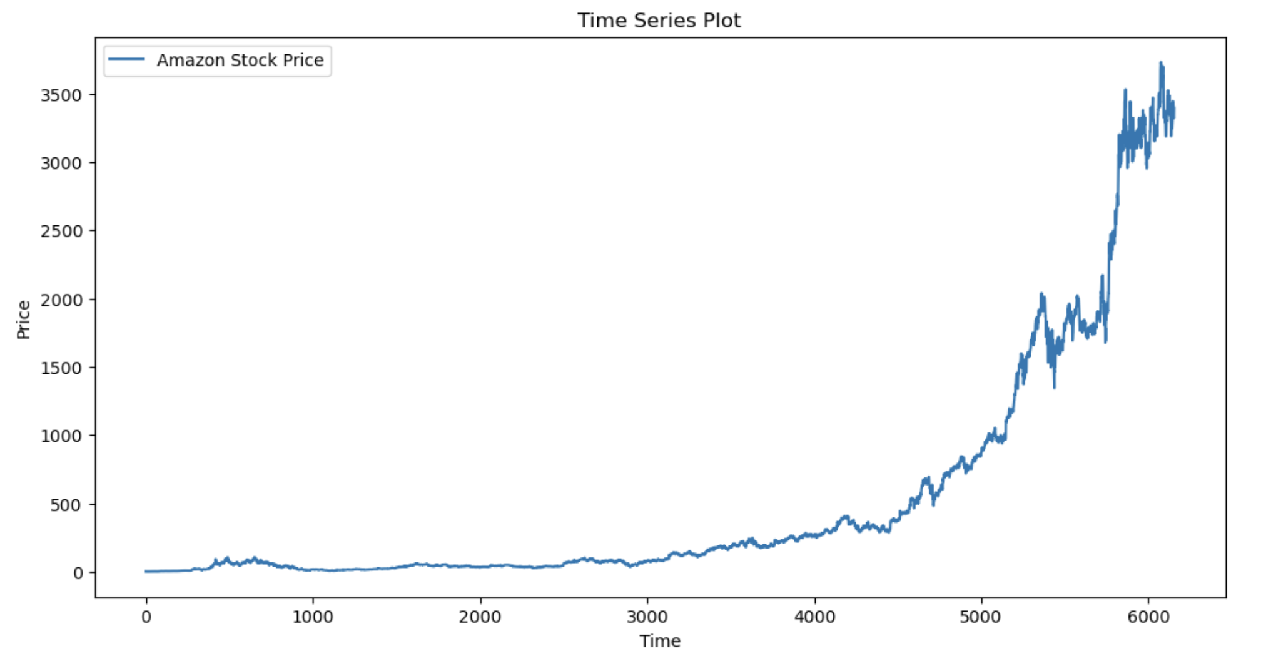
Part 2: Time-series Data Analysis
Dataset: Amazon Stock Price (ALL-TIME)
Reference: https://www.kaggle.com/datasets/kannan1314/amazon-stock-price-all-time

Slide 4
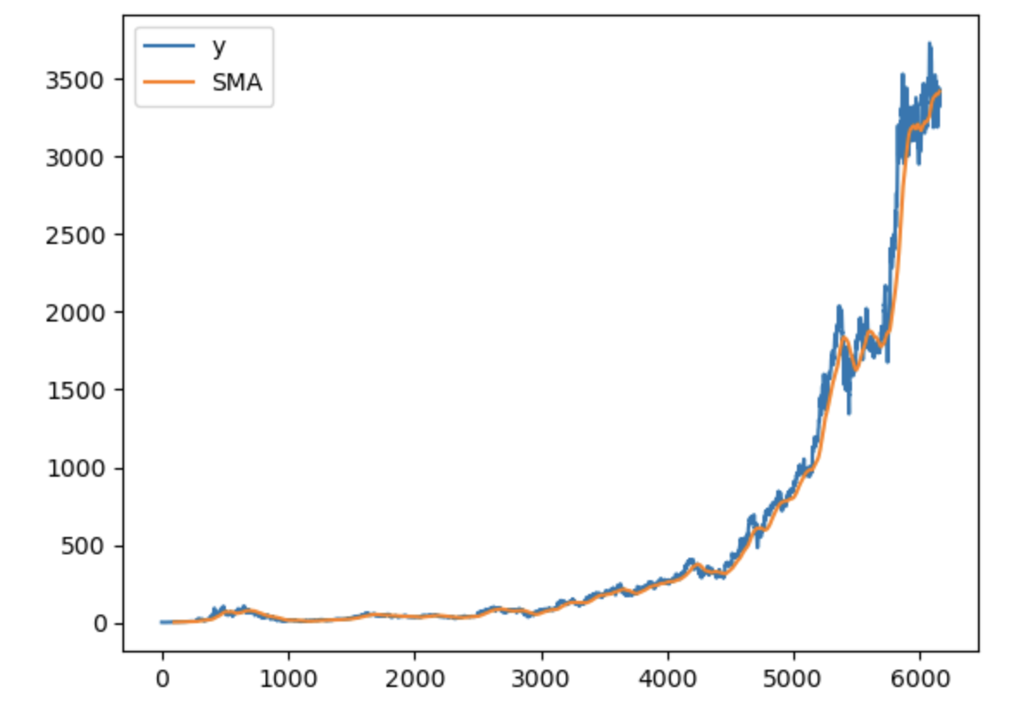
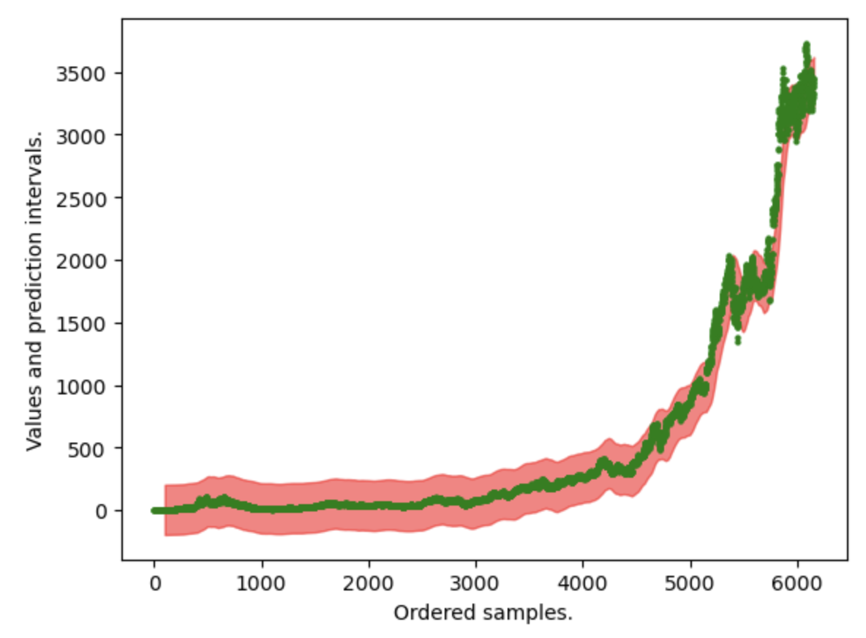
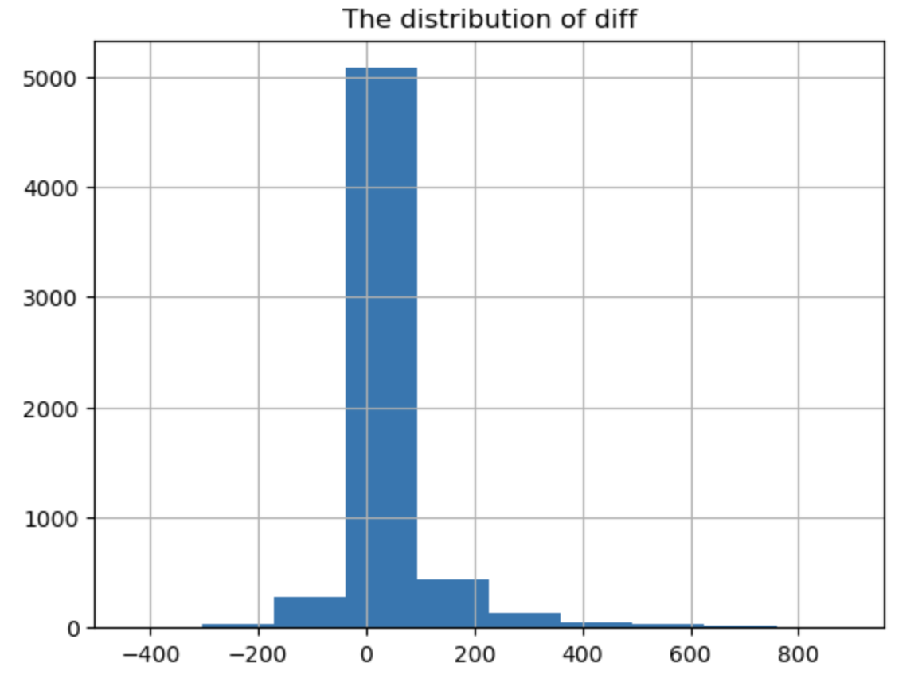
Simple Moving Average (SMA Method)

Slide 5
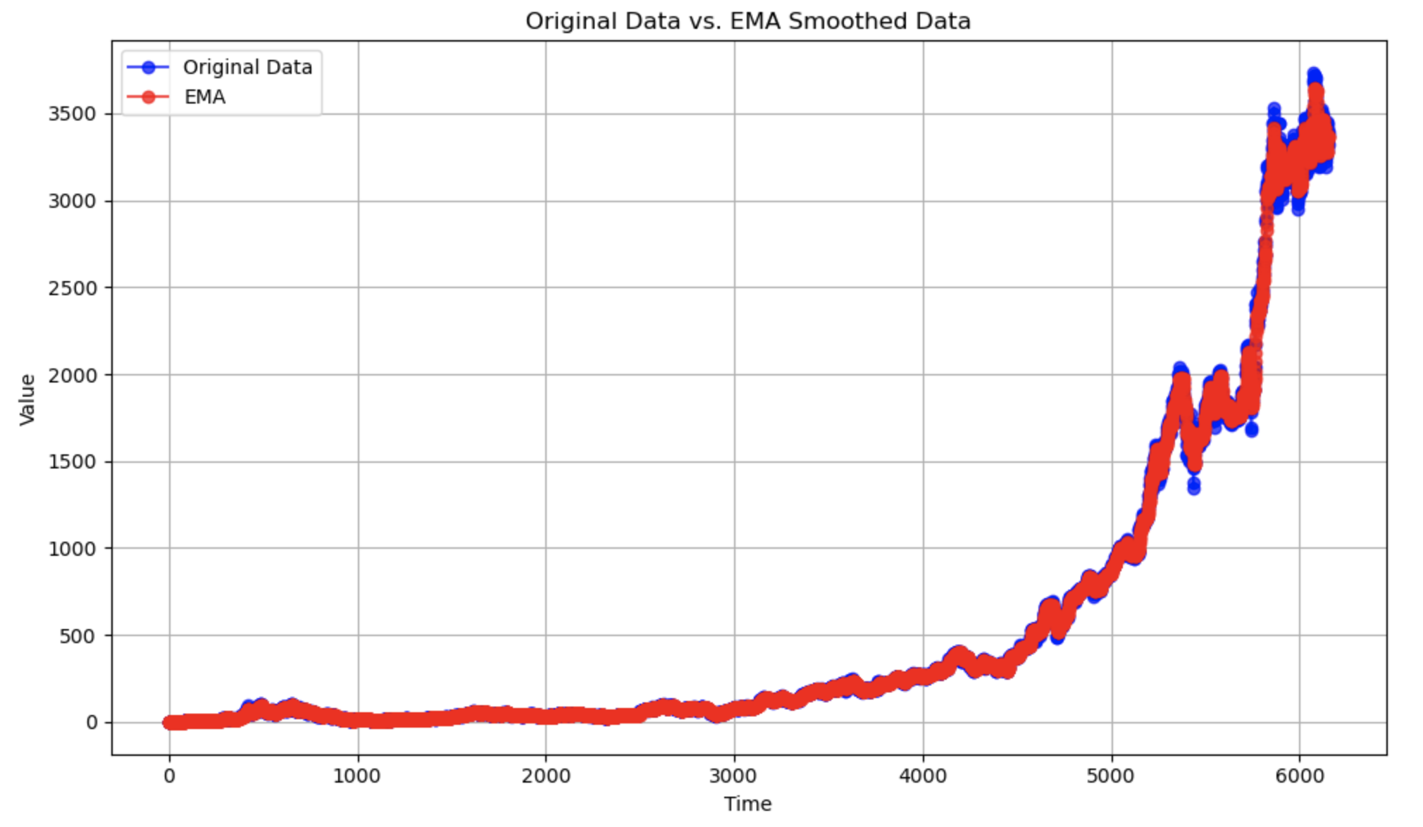
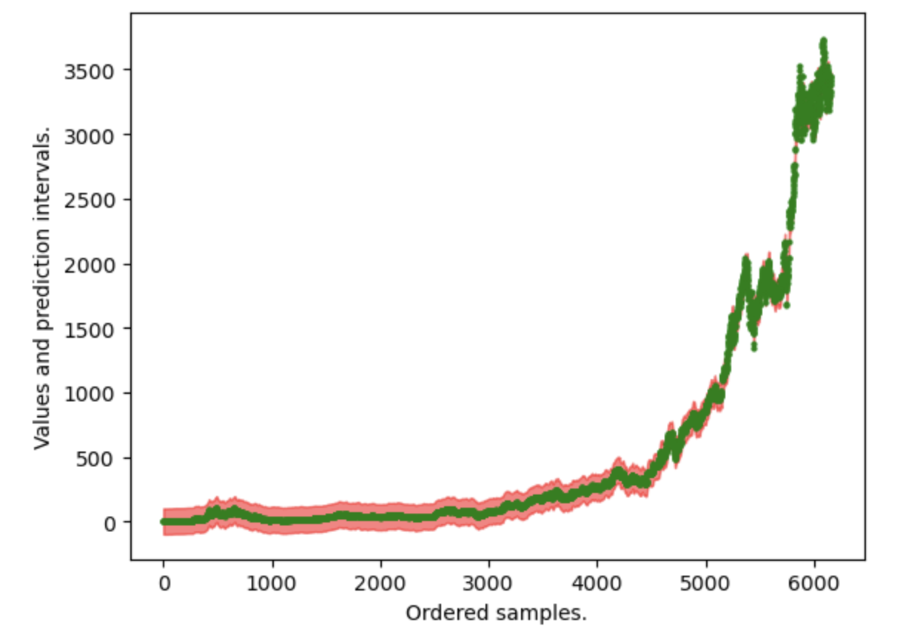
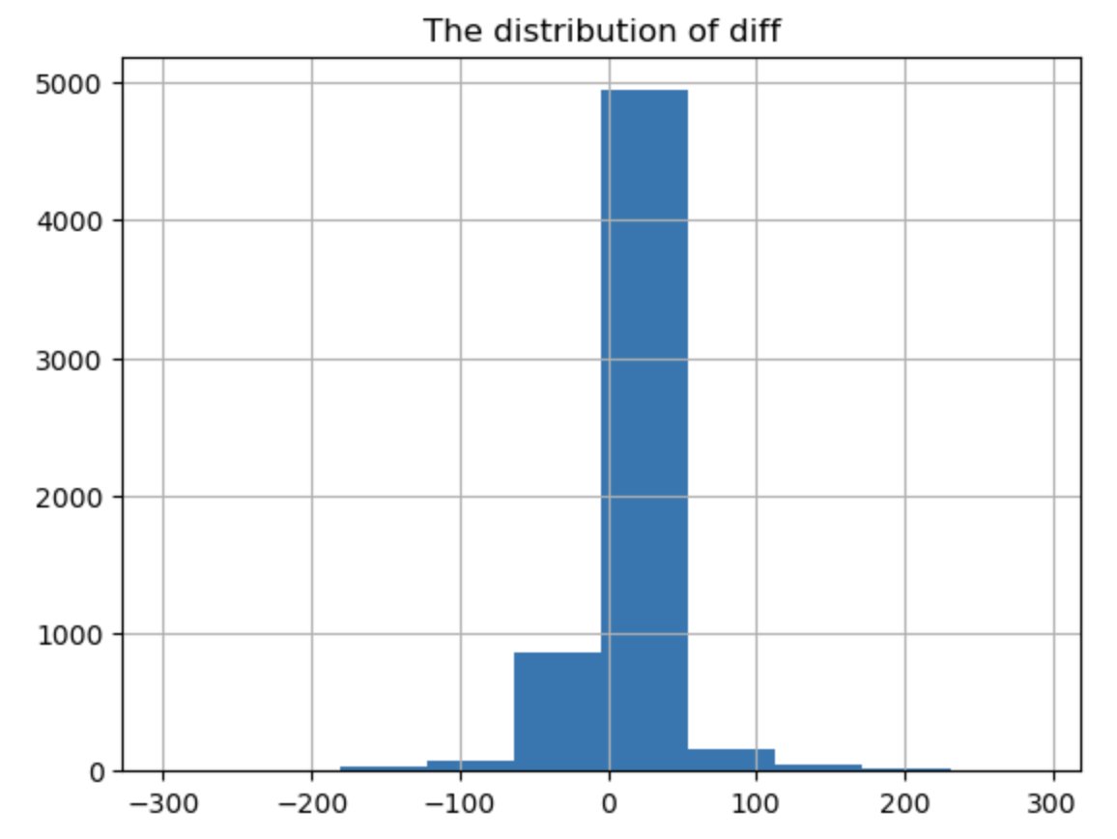
Exponential Smoothing Method

Slide 6
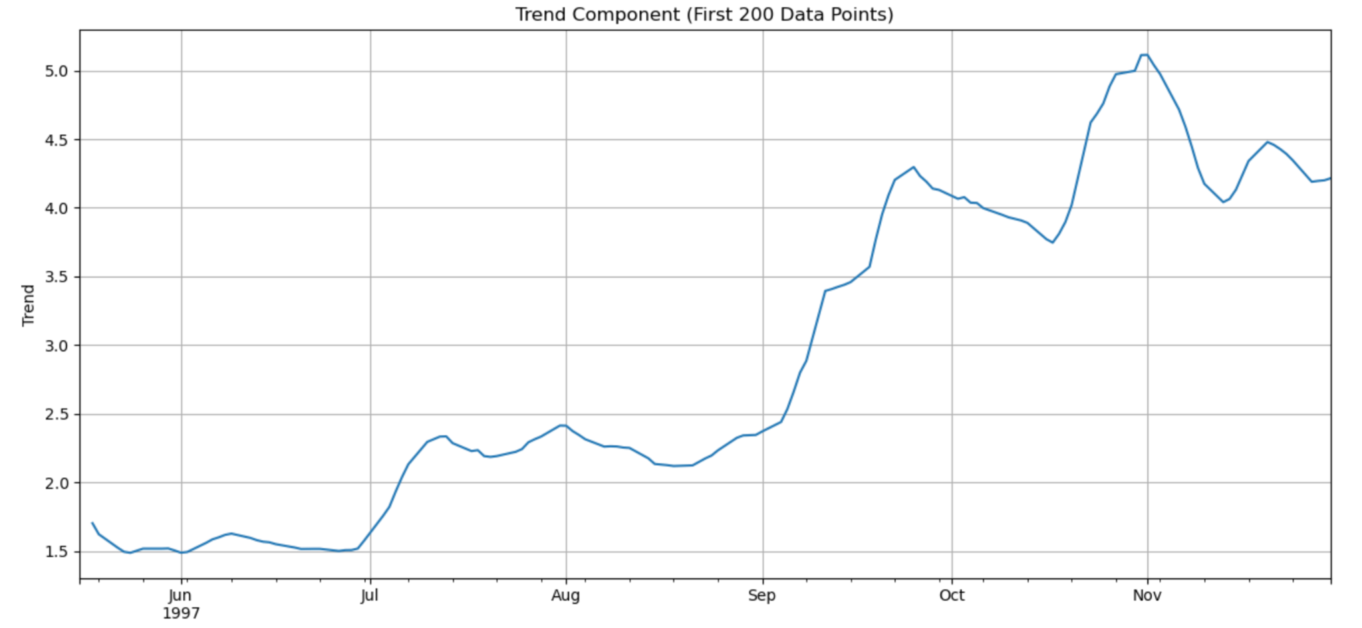
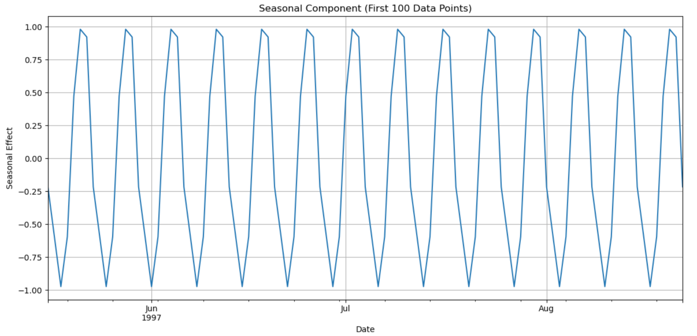
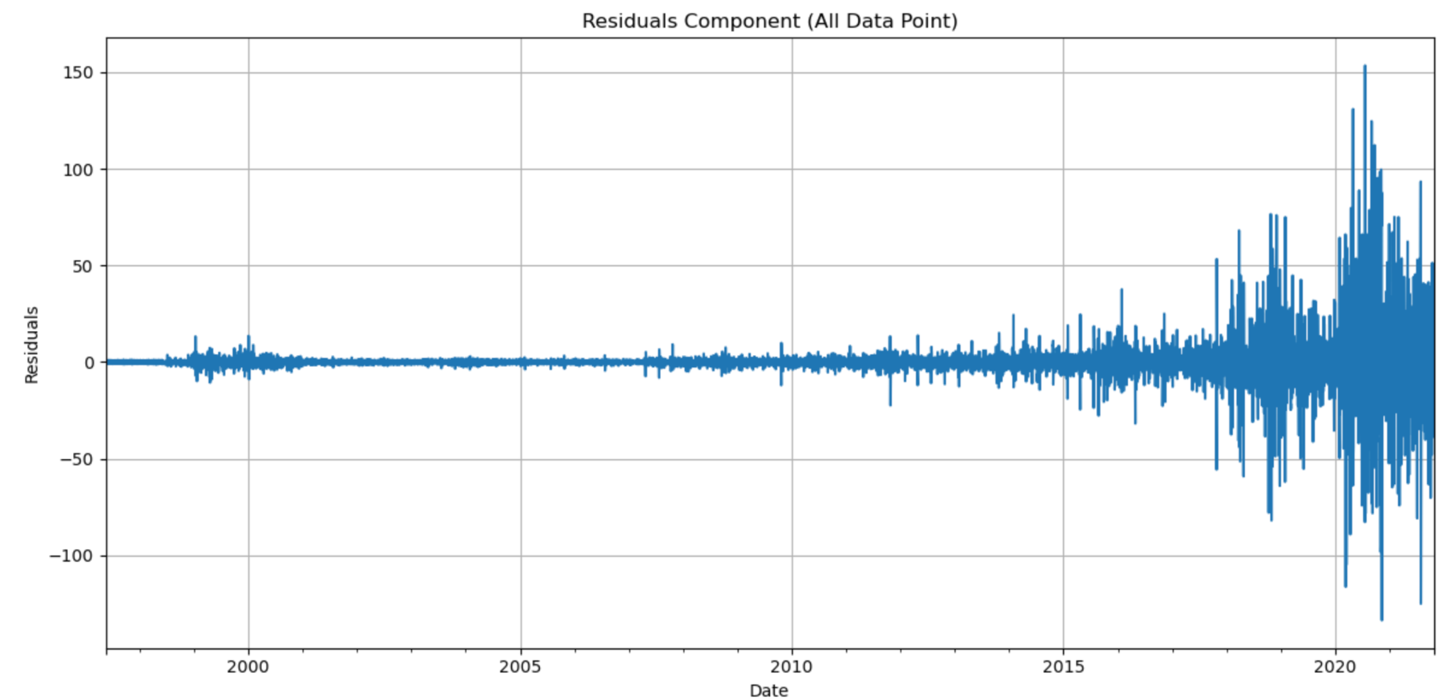
Seasonal-Trend Decomposition (STD Method)

Slide 7
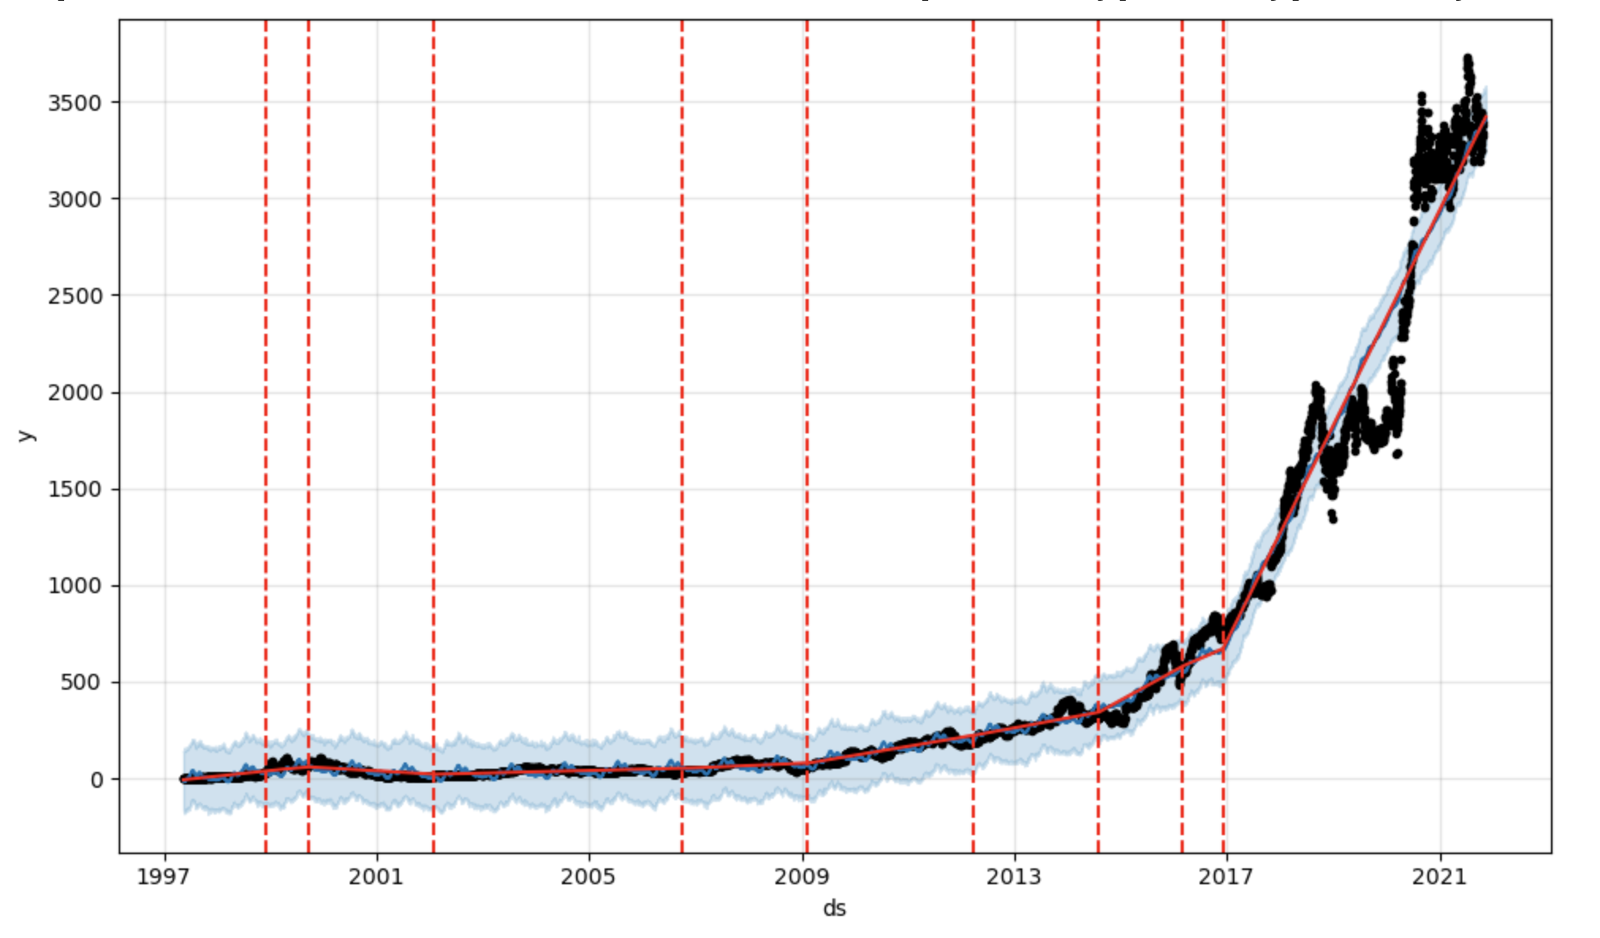
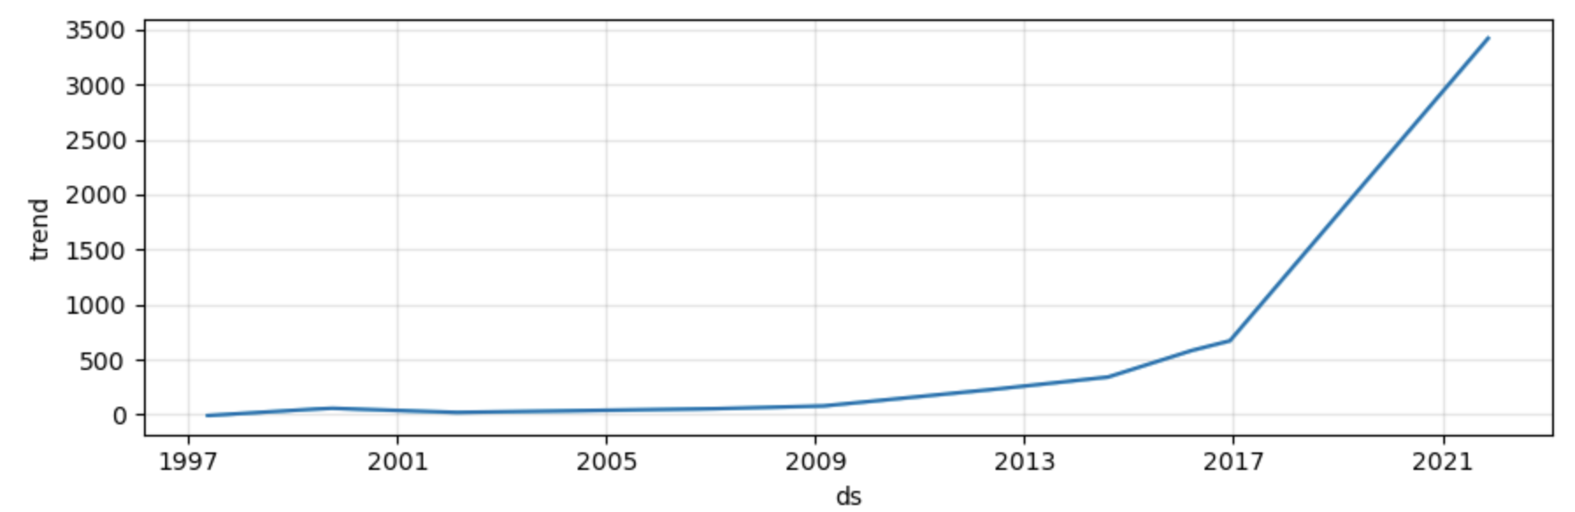
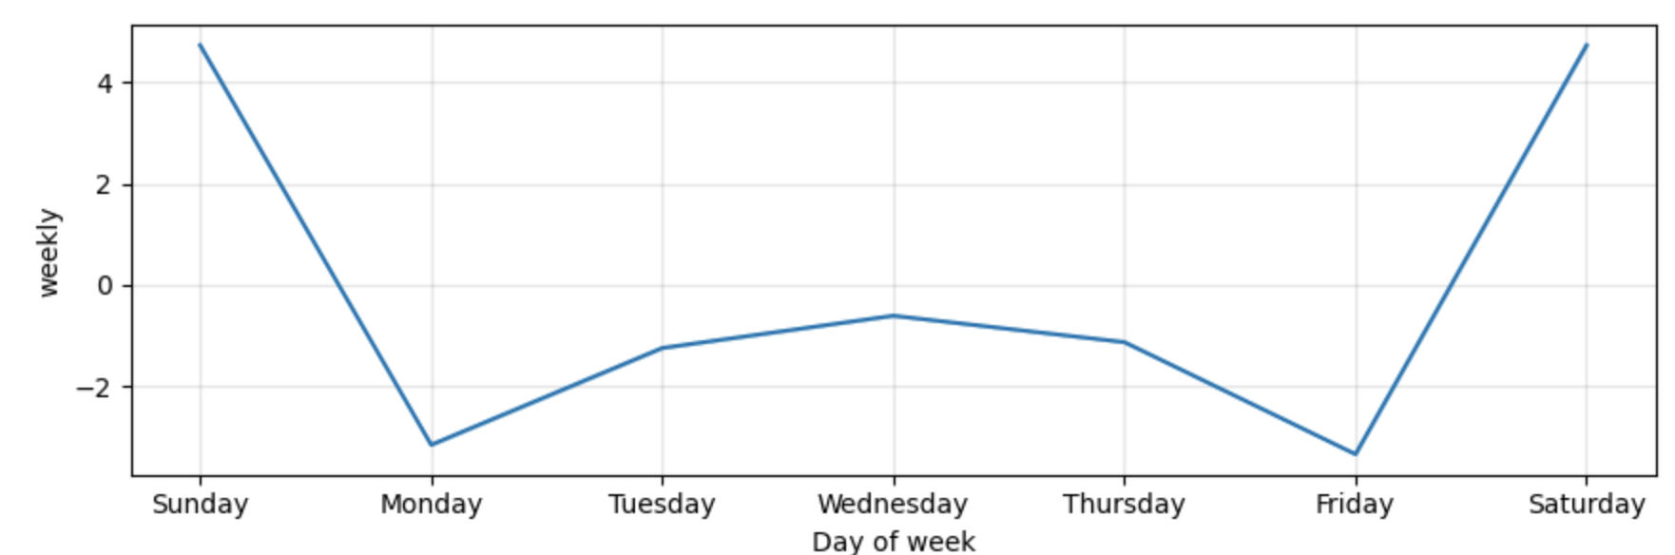
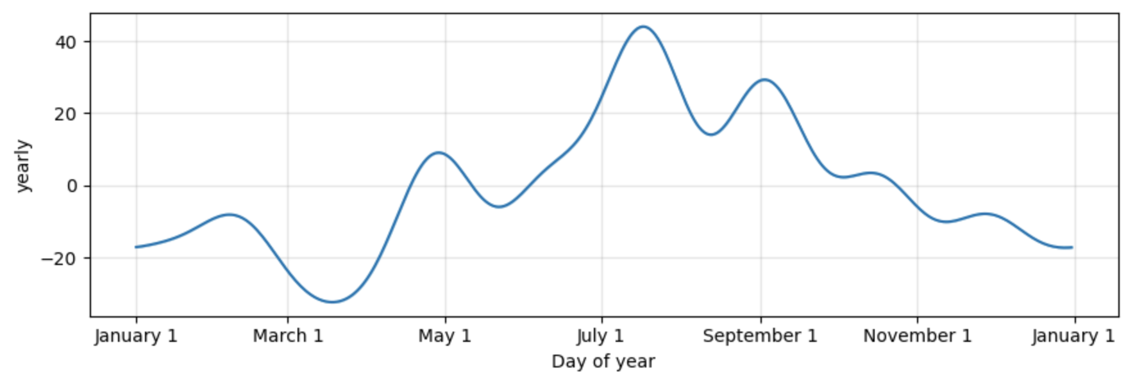
The Prophet Module

Slide 8
Conclusion
Simple Moving Average (SMA): SMA is effective at identifying short-term fluctuations and highlights the underlying trend. By comparing each data point to the moving average, SMA can readily flag periods when the stock price significantly deviates from the smoothed trend, making it a robust tool for identifying short-term anomalies.
Exponential Smoothing: Exponential smoothing generates a smoothed forecast by giving more weight to recent data points. This model's sensitivity to long-term trends and gradual shifts makes it effective at spotting anomalies associated with sustained changes.
Seasonal-Trend Decomposition (STL): STL decomposes the time series data into seasonal, trend, and residual components. It is effective at identifying anomalies because it explicitly separates seasonality and trend from the remainder (residuals). Unusual patterns changes that do not conform to the expected seasonality or trend can be considered anomalies.
Prophet Module: Prophet is designed to handle time series data with complex components like trends, seasonality, and holidays. It identifies anomalies by comparing observed stock prices to forecasted values and their associated prediction intervals. Anomalies are detected when observed values fall outside these intervals.

Slide 9
THANK YOU FOR LISTENING !

